Slide 1

By
The Vibe Engineers

Slide 2

Background

Slide 3
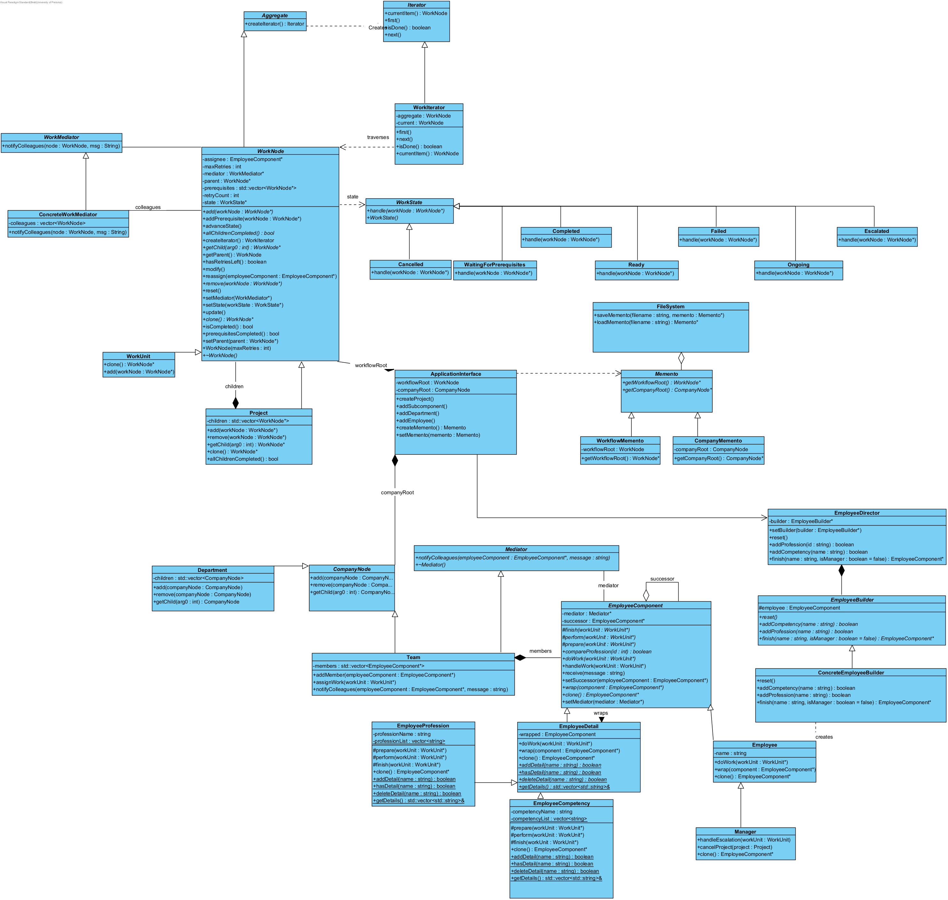
The Design Patterns

Slide 4
The Five Important Patterns:
Composite 1

Slide 5
The Five Important Patterns:
Composite 2

Slide 6
The Five Important Patterns:
Chain

Slide 7
The Five Important Patterns:
Decorator

Slide 8
The Five Important Patterns:
Mediator 1

Slide 9
The Five Important Patterns:
Mediator 2

Slide 10
The Five Important Patterns:
Builder

Slide 11
Activity Diagrams

Slide 12
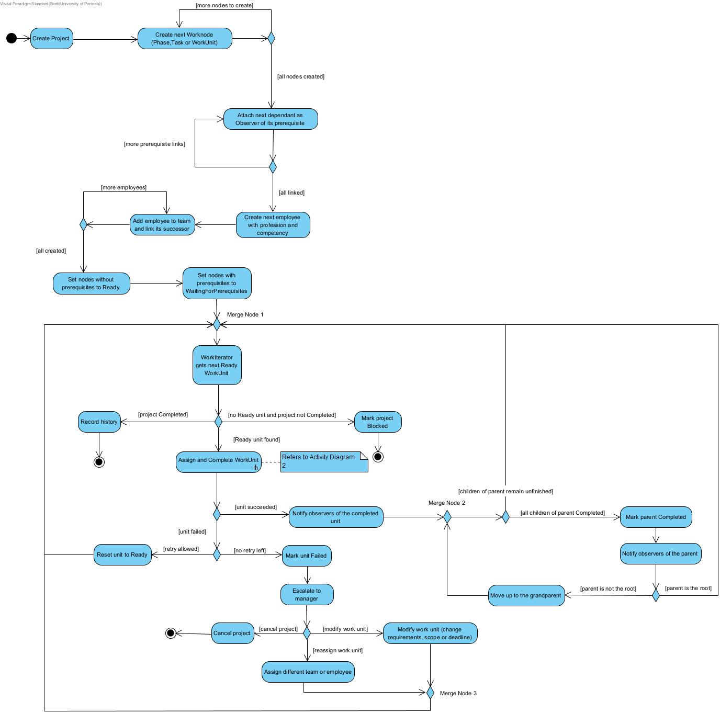
Diagram 1: workflow execution showing the progression of a workflow instance from creation

Slide 13
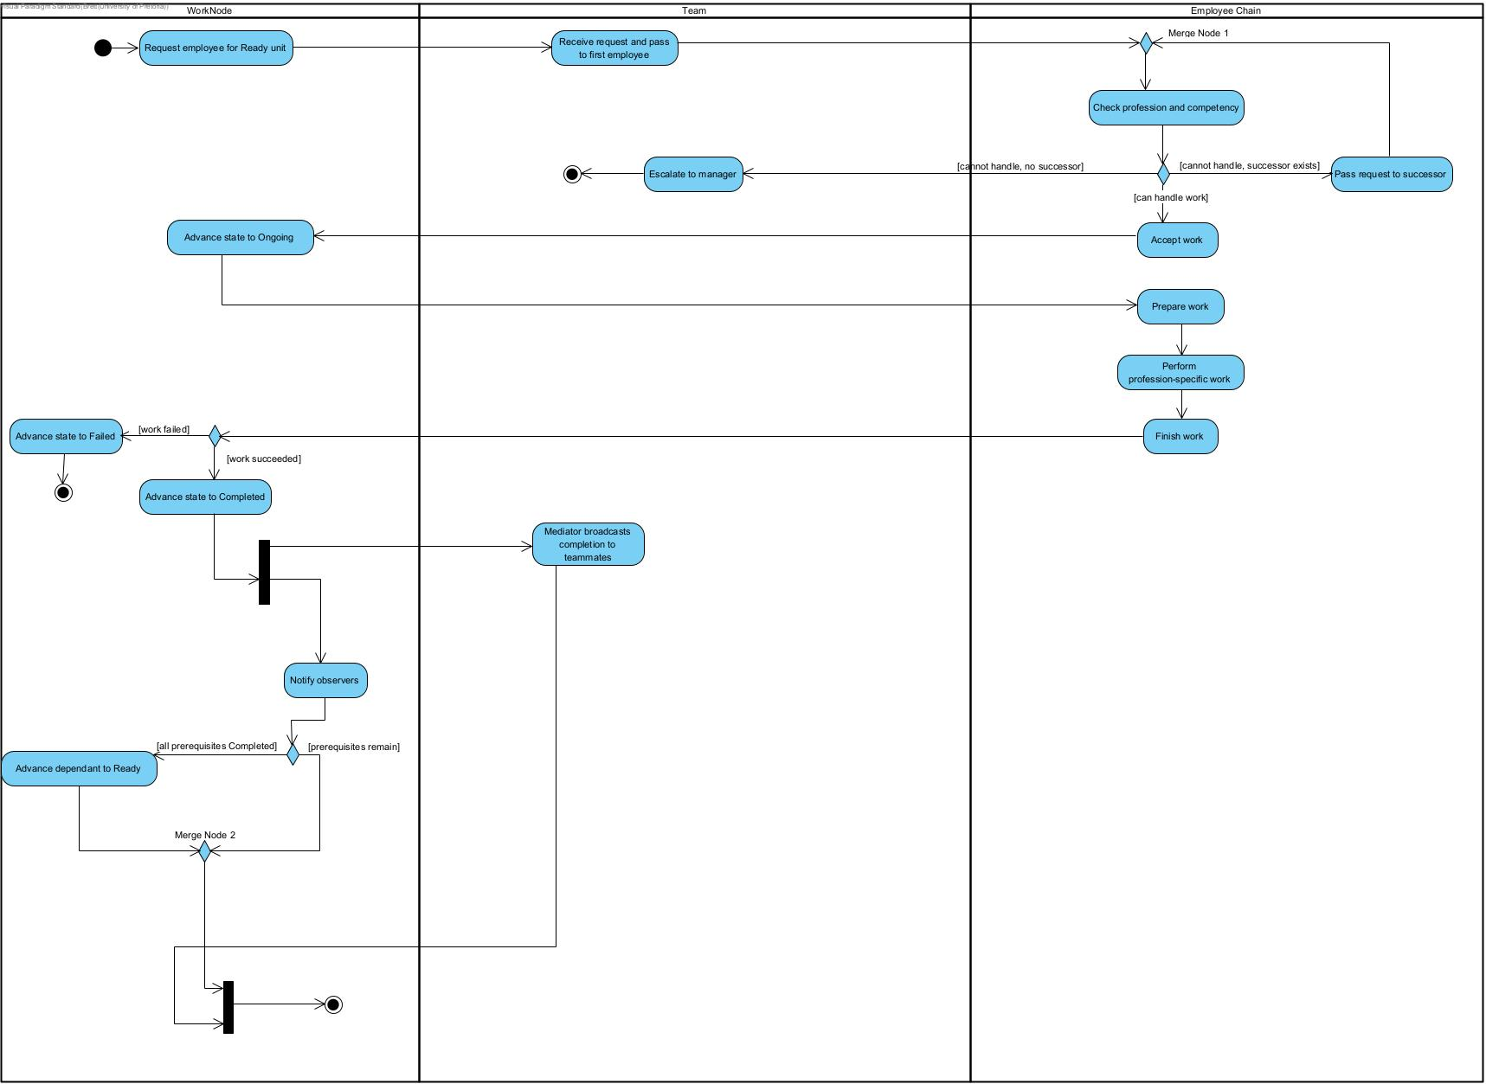
Diagram 2: work assignment and completion, approval and escalation, failure and recovery, or event handling

Slide 14
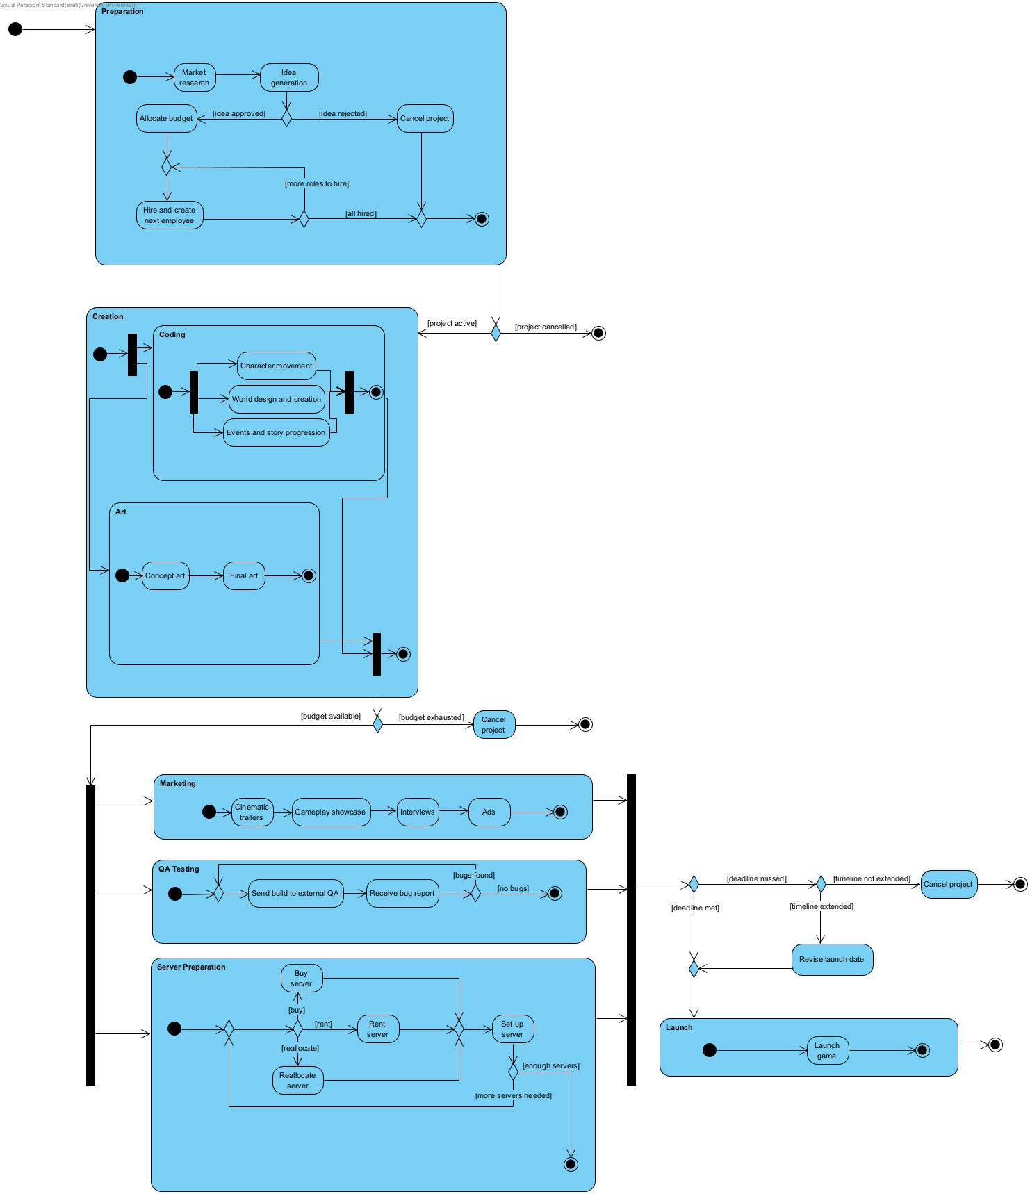
Diagram 3: workflow from your selected scenario

Slide 15
Sequence Diagrams

Slide 16
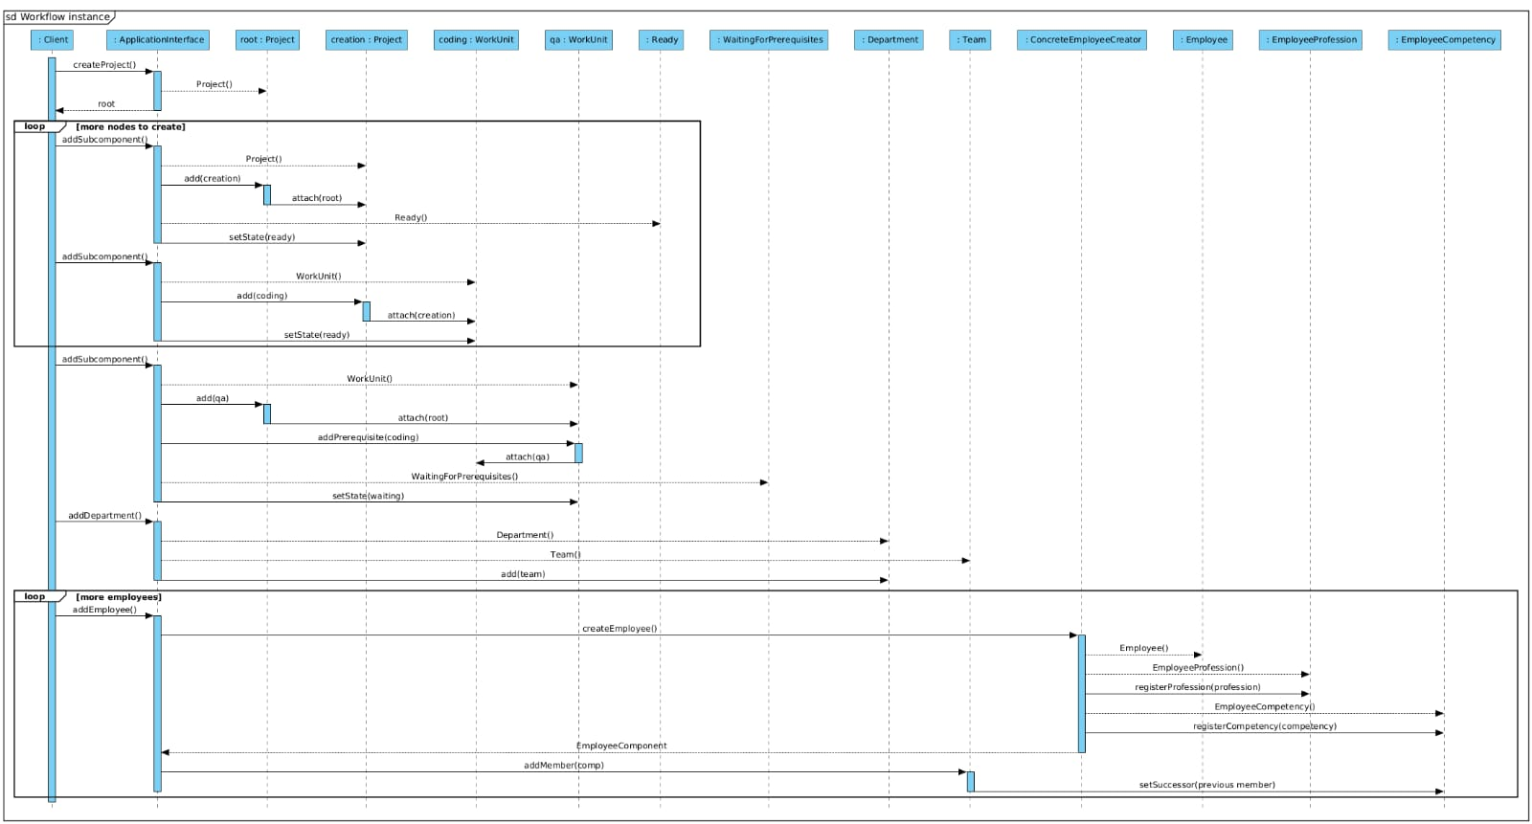
Diagram 1

Slide 17
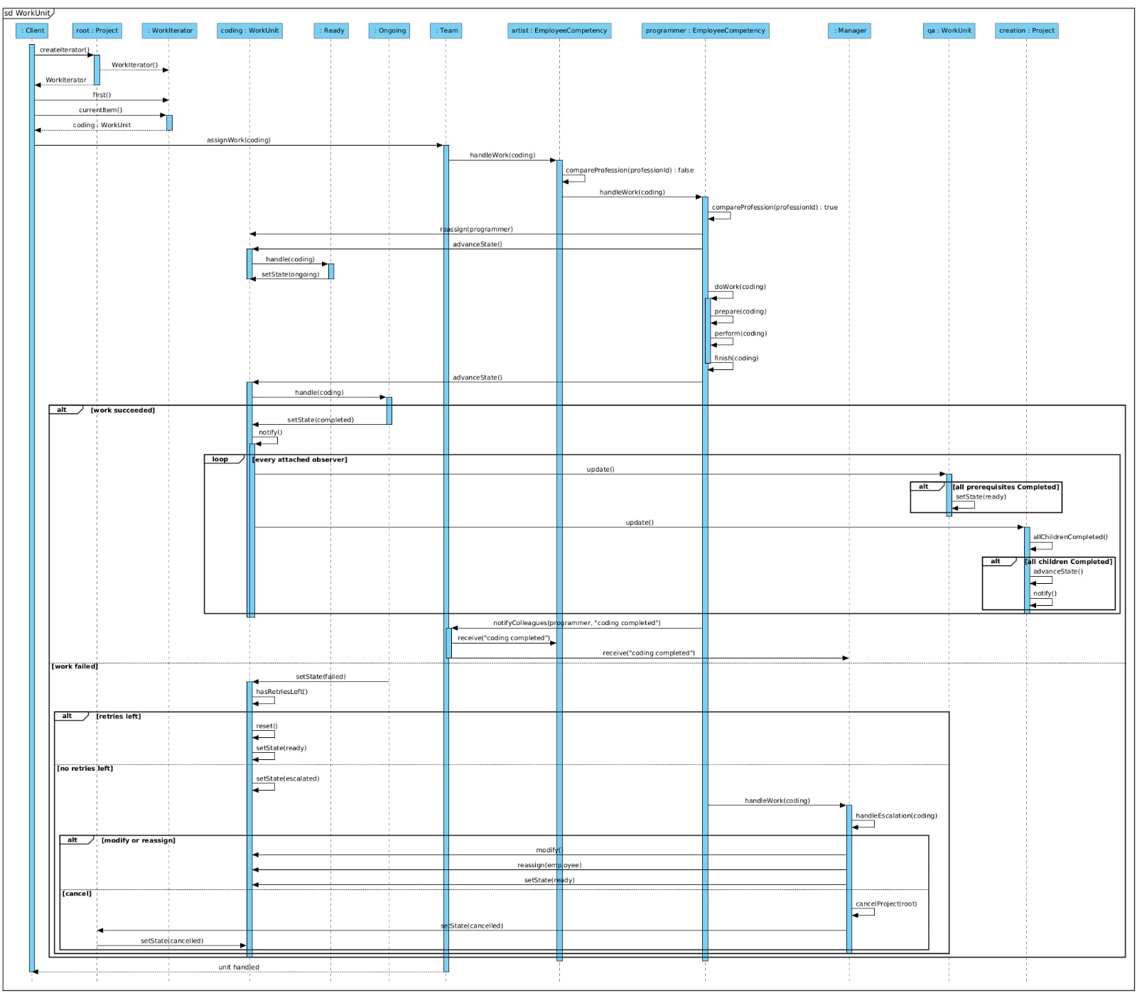
Diagram 2

Slide 18
State Diagram

Slide 19
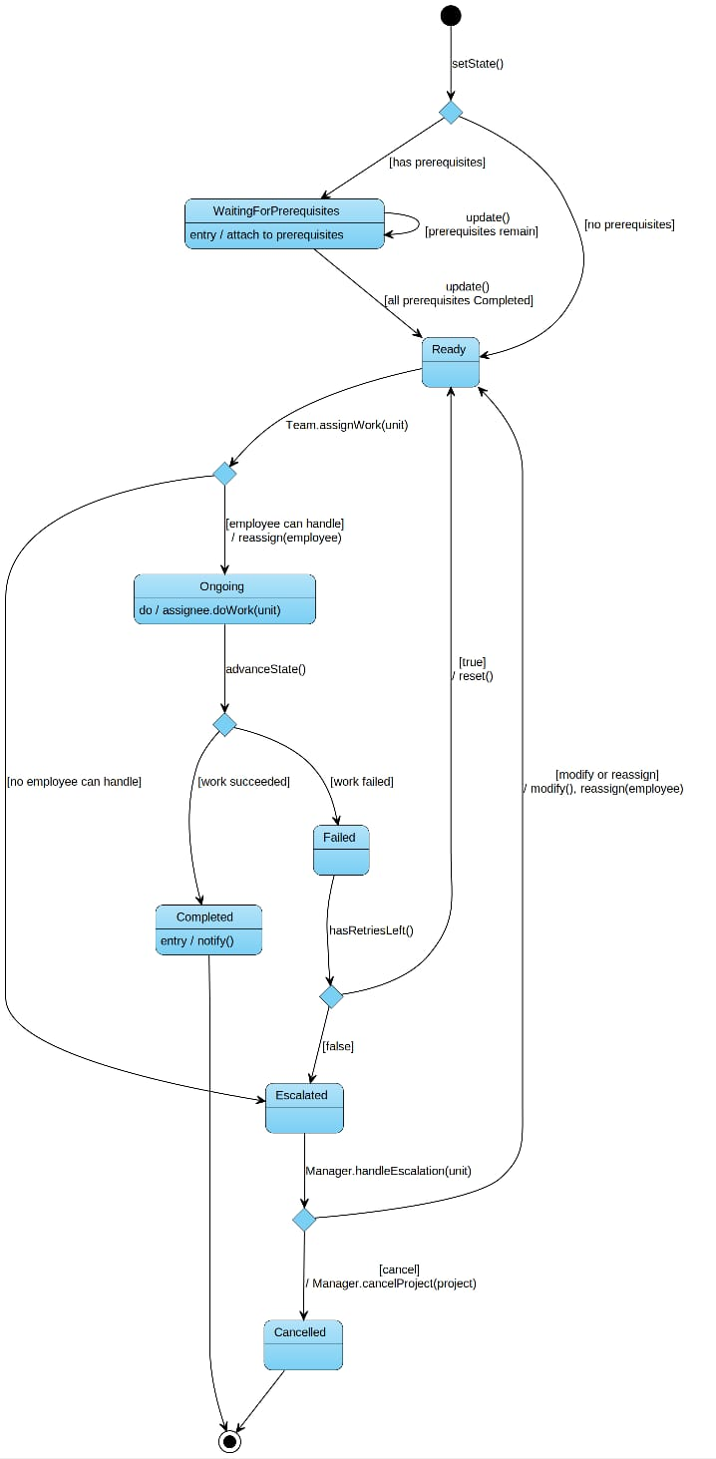
Diagram 1

Slide 20
Live Demo

Slide 21

Any Questions?

Slide 22
Thank you

